Slide 1
Transaction Management

Slide 2
Scheduling Transactions
Serial schedule: Schedule that does not interleave the actions of different transactions.
Equivalent schedules: For any database state, the effect (on the set of objects in the database) of executing the first schedule is identical to the effect of executing the second schedule.
Serializable schedule: A schedule that is equivalent to some serial execution of the transactions.
(Note: If each transaction preserves consistency, every serializable schedule preserves consistency. )

Slide 3
Commutativity
Two operations commute if, when executed in either order:
  The values returned by both are the same and
  The database is left in the same final state
Two schedules are equivalent if one can be derived from the other by a series of simple interchanges of commutative operations
A schedule is serializable if it is equivalent to a serial schedule

Slide 4

Testing for Serializability
Consider some schedule of a set of transactions T₁, T₂, ..., T_{n}
Precedence graph — a direct graph where the vertices are the transactions (names).
We draw an arc from T_{i} to T_{j} if the two transaction conflict, and T_{i} accessed the data item on which the conflict arose earlier.
We may label the arc by the item that was accessed.
Example 1
x
y

Slide 5
Example Schedule (Schedule A) + Precedence Graph
T₁ T₂ T₃ T₄ T₅
read(X)
read(Y)
read(Z)
read(V)
read(W)
read(W)
read(Y)
write(Y)
write(Z)
read(U)
read(Y)
write(Y)
read(Z)
write(Z)
read(U)
write(U)
T₁
T₂
T₄
T₃
T₅

Slide 6

Test for Conflict Serializability
A schedule is conflict serializable if and only if its precedence graph is acyclic.
Cycle-detection algorithms exist which take order n² time, where n is the number of vertices in the graph.
  (Better algorithms take order n + e where e is the number of edges.)
If precedence graph is acyclic, the serializability order can be obtained by a topological sorting of the graph.
  This is a linear order consistent with the partial order of the graph.
  For example, a serializability order for Schedule A would be
  T₅ → T₁ → T₃ → T₂ → T₄
    Are there others?

Slide 7
Example 1
T₁: {R₁(x), x = x+1, W₁(x), C₁}
T₂: {R₂(x), x = x+1, W₂(x), C₂}
Conflicting operations between T₁ and T₂:
{ (R₁(x), W₂(x)) , (R₂(x), W₁(x)) , (W₂(x),W₁(x)) }
Complete Schedule
We need to order these conflicting operations, e.g.,
R₁(x) → W₂(x)
R₂(x) → W₁(x)
W₂(x) → W₁(x)
T₁
R₁(X)
W₁(X)
C₁
T₂
R₂(X)
W₂(X)
C₂
Notes:
2
2

Slide 8
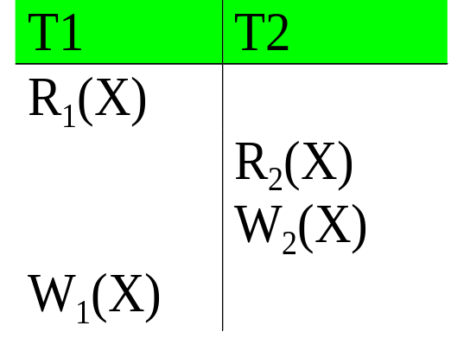
Another Way of Representing Schedules
T₁
R₁(X)
W₁(X)
C₁
T₂
R₂(X)
W₂(X)
C₂
Note the explicit ordering of R₁(X) and R₂(X)
Notes:
2
2

Slide 9
Example 2
T₁ = R₁(x) → W₁(x) → C₁
T₂ = R₂(x) → W₂(y) → W₂(x) → C₂
T₃ = R₃(y) → W₃(x) → W₃(y) → W₃(z) → C₃
T₂
R₂(x) → W₂(y) → W₂(x) → C₂
T₃
R₃(y) → W₃(x) → W₃(y) → W₃(z) → C₃
T₁
R₁(x) → W₁(x) → C₁
Notes:
2
2

Slide 10
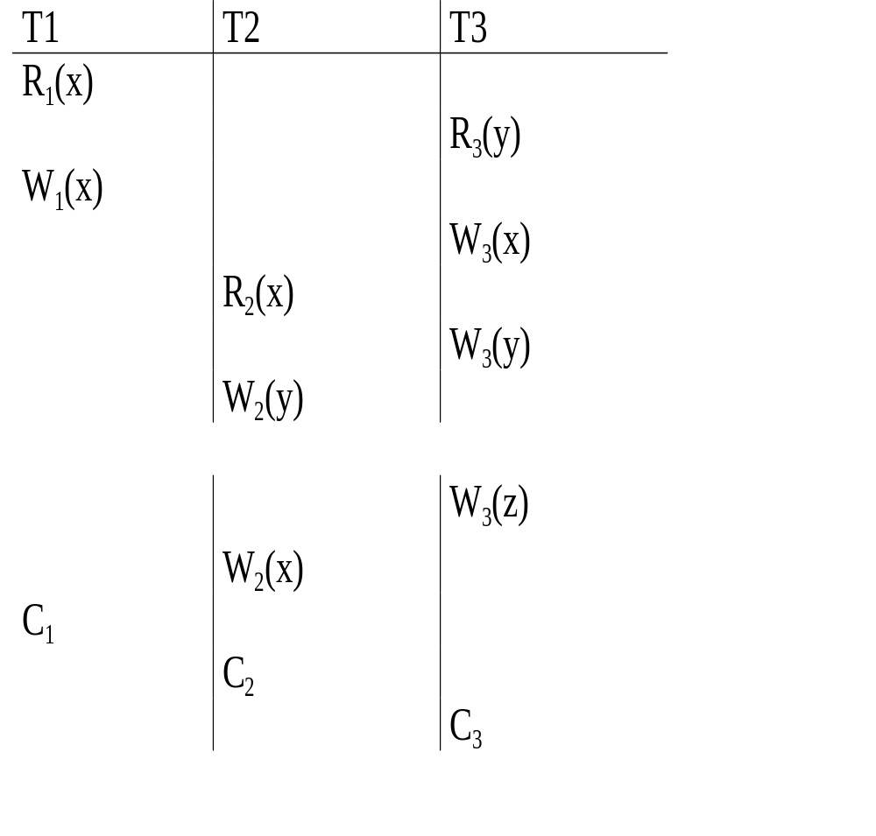
Example 2 in Table Form
T₂
R₂(x) → W₂(y) → W₂(x) → C₂
T₃
R₃(y) → W₃(x) → W₃(y) → W₃(z) → C₃
T₁
R₁(x) → W₁(x) → C₁
Notes:
2
2

Slide 11
Precedence Graph
A set of transactions may have many possible schedules, which ones are correct?
  Answer: use precedence graph
Precedence graph is a directed graph:
  nodes/vertices as transactions
  edges denoting precedence relationship between conflicting operations of different transactions.
For a pair of conflicting operations O_{ij} ∈ T_{i} and O_{kl} ∈ T_{k},
  if O_{ij} → O_{kl} then have an edge from T_{i} to T_{k}, else
  if O_{kl} → O_{ij} then have an edge from T_{k} to T_{i}
If there are more than one edge between two nodes, retain only one of the edges
Notes:
2
2

Slide 12
Precedence Graph of Example 1
T₁
R₁(X)
W₁(X)
C₁
Since there are two transactions,
we have two nodes T₁ and T₂
T₂
R₂(X)
W₂(X)
C₂
R₁(X) → W₂(X) ⇒ edge T₁ → T₂;
R₂(X) → W₁(X) ⇒ edge T₂ → T₁,
T1
T2
W₂(X) → W₁(X) ⇒ edge T₂ → T₁
A cycle in Precedence Graph implies potential for database inconsistency
Notes:
2
2
Connect to tutorial oriented presentation, and emphasize our approach

Slide 13
Precedence Graph of Example 2
T₁ = R₁(x) → W₁(x) → C₁
T₂ = R₂(x) → W₂(y) → W₂(x) → C₂
T₃ = R₃(y) → W₃(x) → W₃(y) → W₃(z) → C₃
T₂
R₂(x) → W₂(y) → W₂(x) → C₂
T1
T3
T2
T₃
R₃(y) → W₃(x) → W₃(y) → W₃(z) → C₃
T1 → T3 because W₁(x) → W₃(x);
T3 → T2 because W₃(x) → R₂(x);
T1 → T2 because W₁(x) → W₂(x)
No cycle in precedence graph so no database inconsistency.
T₁
R₁(x) → W₁(x) → C₁
Notes:
2
2

Slide 14
Using Another Schedule for Example 2
T₁ = R₁(x) → W₁(x) → C₁
T₂ = R₂(x) → W₂(y) → W₂(x) → C₂
T₃ = R₃(y) → W₃(x) → W₃(y) → W₃(z) → C₃
R₂(x) → W₂(y) → W₂(x) → C₂
T₁ → T₃ → T₂
R₃(y) → W₃(x) → W₃(y) → W₃(z) → C₃
R₁(x) → W₁(x) → C₁
PG has a cycle; the database may not be consistent
Notes:
2
2

Slide 15
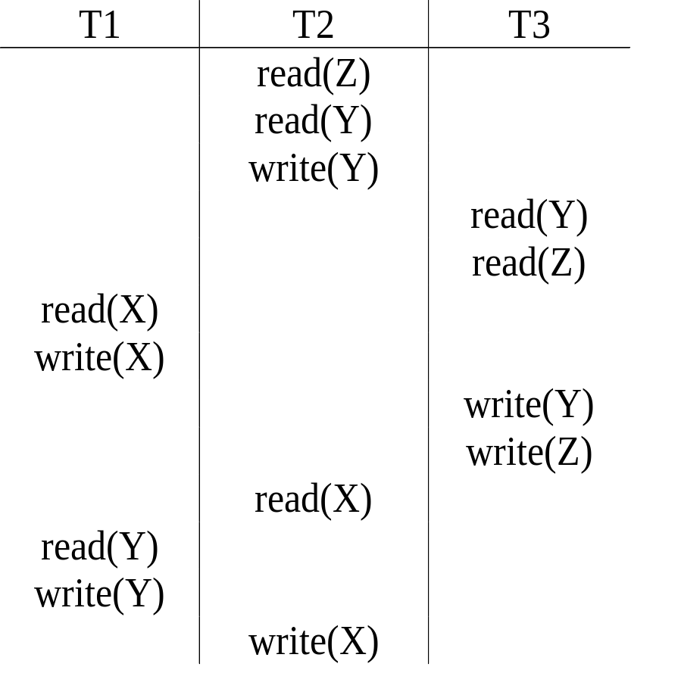
Another Example on Serializability
T1
T2
T3
Schedule is NOT serializable
Notes:
2
2

Slide 16
Run-time Construction of Precedence Graph
T₁ = R₁(x) → W₁(x) → C₁
T₂ = R₂(x) → W₂(y) → W₂(x) → C₂
T₃ = R₃(y) → W₃(x) → W₃(y) → W₃(z) → C₃
R₂(x) → W₂(y)
Schedule = R₃(y) → W₃(x) → W₃(y)
R₁(x) → W₁(x) → C₁
The scheduler keeps building the Precedence Graph as the operations of active transactions are scheduled so that the PG is acyclic.
The scheduler delays scheduling those operation that can cause a cycle in PG
Notes:
2
2

Slide 17
View Serializability
Let S and S´ be two schedules with the same set of transactions. S and S´ are view equivalent if the following three conditions are met, for each data item Q,
  If in schedule S, transaction T_{i} reads the initial value of Q, then in schedule S’ also transaction T_{i} must read the initial value of Q.
  If in schedule S transaction T_{i} executes read(Q), and that value was produced by transaction T_{j} (if any), then in schedule S’ also transaction T_{i} must read the value of Q that was produced by the same write(Q) operation of transaction T_{j} .
  The transaction (if any) that performs the final write(Q) operation in schedule S must also perform the final write(Q) operation in schedule S’.
As can be seen, view equivalence is also based purely on reads and writes alone.

Slide 18

View Serializability (Cont.)
A schedule S is view serializable if it is view equivalent to a serial schedule.
Every conflict serializable schedule is also view serializable.
Below is a schedule which is view-serializable but not conflict serializable.
Every view serializable schedule that is not conflict serializable has blind writes.

Slide 19
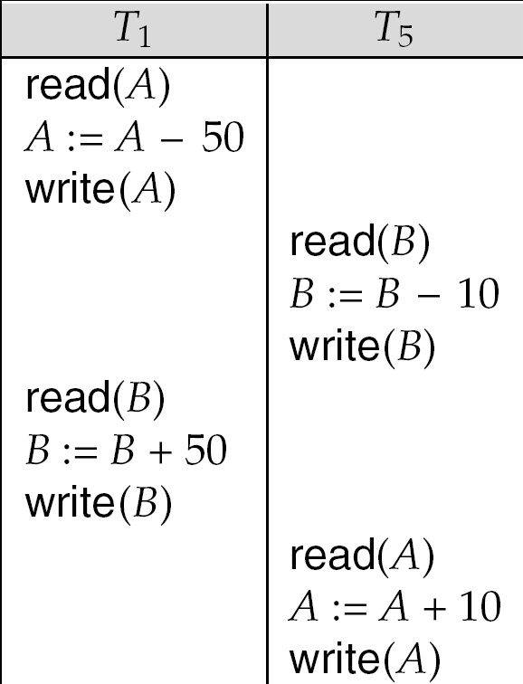
Other Notions of Serializability
The schedule below produces same outcome as the serial schedule < T₁, T₅ >, yet is not conflict equivalent or view equivalent to it.
Determining such equivalence requires analysis of operations other than read and write.

Slide 20
Test for View Serializability
The precedence graph test for conflict serializability cannot be used directly to test for view serializability.
  Extension to test for view serializability has cost exponential in the size of the precedence graph.
The problem of checking if a schedule is view serializable falls in the class of NP-complete problems.
  Thus existence of an efficient algorithm is extremely unlikely.
However practical algorithms that just check some sufficient conditions for view serializability can still be used.

Slide 21
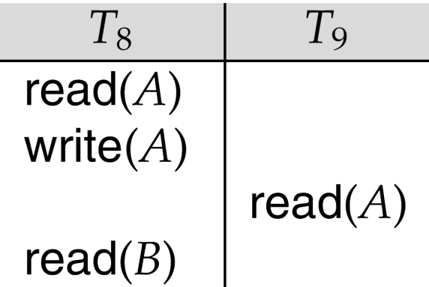
Recoverable Schedules
Need to address the effect of transaction failures on concurrently
running transactions.
Recoverable schedule — if a transaction T_{j} reads a data item previously written by a transaction T_{i} , then the commit operation of T_{i} appears before the commit operation of T_{j}.
The following schedule (Schedule 11) is not recoverable if T₉ commits immediately after the read
If T₈ should abort, T₉ would have read (and possibly shown to the user) an inconsistent database state. Hence, database must ensure that schedules are recoverable.

Slide 22

Cascading Rollbacks
Cascading rollback – a single transaction failure leads to a series of transaction rollbacks. Consider the following schedule where none of the transactions has yet committed (so the schedule is recoverable)
If T₁₀ fails, T₁₁ and T₁₂ must also be rolled back.
Can lead to the undoing of a significant amount of work

Slide 23
Cascadeless Schedules
Cascadeless schedules — cascading rollbacks cannot occur; for each pair of transactions T_{i} and T_{j} such that T_{j} reads a data item previously written by T_{i}, the commit operation of T_{i} appears before the read operation of T_{j}.
Every cascadeless schedule is also recoverable
It is desirable to restrict the schedules to those that are cascadeless

Slide 24
Methods for Serialisability
Multi-version Concurrency Control techniques keep the old values of a data item when that item is updated.
Timestamps are unique identifiers for each transaction and are generated by the system. Transactions can then be ordered according to their timestamps to ensure serialisability.
Protocols that, if followed by every transaction, will ensure serialisability of all schedules in which the transactions participate. They may use locking techniques of data items to prevent multiple transactions from accessing items concurrently.
Pessimistic Concurrency Control
  Check before a database operation is executed by locking data items before they are read and written or checking timestamps

Slide 25
Locking Techniques for Concurrency Control
The concept of locking data items is one of the main techniques used for controlling the concurrent execution of transactions.
A lock is a variable associated with a data item in the database. Generally there is a lock for each data item in the database.
A lock describes the status of the data item with respect to possible operations that can be applied to that item. It is used for synchronising the access by concurrent transactions to the database items.
A transaction locks an object before using it
When an object is locked by another transaction, the requesting transaction must wait

Slide 26
Types of Locks
Binary locks have two possible states:
  1. locked (lock_item(X) operation) and
  2. unlocked (unlock_item(X) operation
Multiple-mode locks allow concurrent access to the same item by several transactions. Three possible states:
  1. read locked or shared locked (other transactions are allowed to read the item)
  2. write locked or exclusive locked (a single transaction exclusively holds the lock on the item) and
  3. unlocked.
Locks are held in a lock table.
  upgrade lock: read lock to write lock
  downgrade lock: write lock to read lock

Slide 27
Lock-Based Protocols
A lock is a mechanism to control concurrent access to a data item
Data items can be locked in two modes :
1. exclusive (X) mode. Data item can be both read as well as
written. X-lock is requested using lock-X instruction.
2. shared (S) mode. Data item can only be read. S-lock is
requested using lock-S instruction.
Lock requests are made to concurrency-control manager. Transaction can proceed only after request is granted.

Slide 28

Lock-Based Protocols
Lock-compatibility matrix
A transaction may be granted a lock on an item if the requested lock is compatible with locks already held on the item by other transactions
Any number of transactions can hold shared locks on an item,
  but if any transaction holds an exclusive on the item no other transaction may hold any lock on the item.

Slide 29
Lock-Based Protocols
If a lock cannot be granted, the requesting transaction is made to wait till all incompatible locks held by other transactions have been released. The lock is then granted.

Slide 30
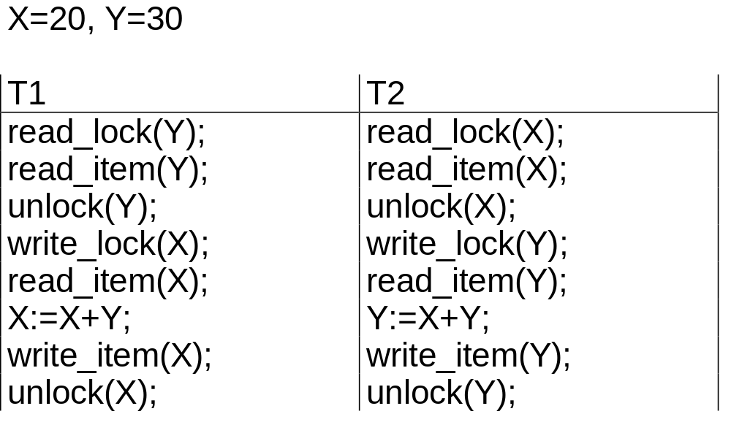
Locks don’t guarantee serialisability
X is unlocked too early
Y is unlocked too early
Schedule 1: T1 followed by T2 ⇒ X=50, Y=80
Schedule 2: T2 followed by T1 ⇒ X=70, Y=50

Slide 31
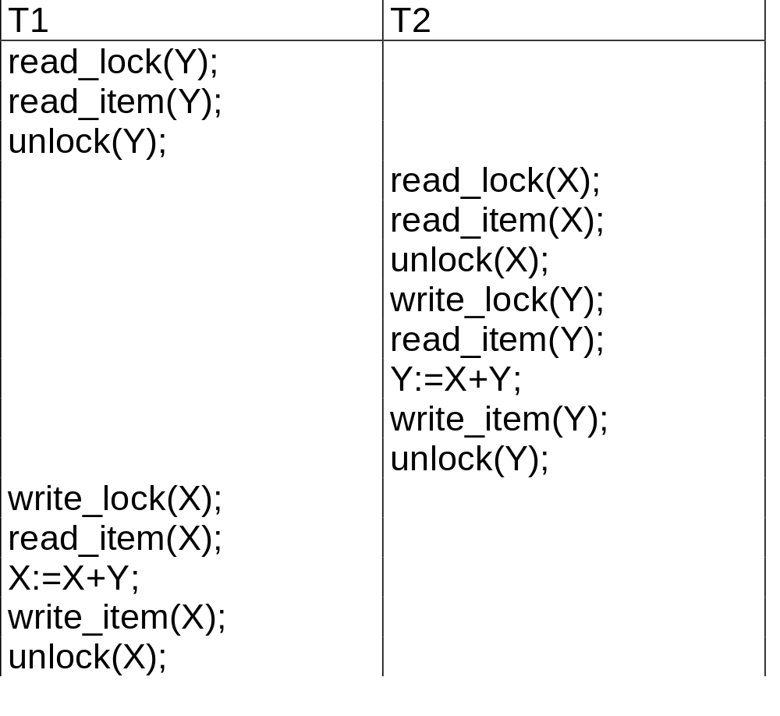
Non-serialisable schedule S that uses locks
X=20Y=30
result of S ⇒ X=50, Y=50

Slide 32

Pitfalls of Lock-Based Protocols
Consider the partial schedule
Neither T₃ nor T₄ can make progress — executing lock-S(B) causes T₄ to wait for T₃ to release its lock on B, while executing lock-X(A) causes T₃ to wait for T₄ to release its lock on A.
Such a situation is called a deadlock.
  To handle a deadlock one of T₃ or T₄ must be rolled back
  and its locks released.

Slide 33
Pitfalls of Lock-Based Protocols
The potential for deadlock exists in most locking protocols. Deadlocks are a necessary evil.
Starvation is also possible if concurrency control manager is badly designed. For example:
  A transaction may be waiting for an X-lock on an item, while a sequence of other transactions request and are granted an S-lock on the same item.
  The same transaction is repeatedly rolled back due to deadlocks.
Concurrency control manager can be designed to prevent starvation.

Slide 34
The Two-Phase Locking Protocol
This is a protocol which ensures conflict-serializable schedules.
Phase 1: Growing Phase
  transaction may obtain locks
  transaction may not release locks
Phase 2: Shrinking Phase
  transaction may release locks
  transaction may not obtain locks
The protocol assures serializability. It can be proved that the transactions can be serialized in the order of their lock points (i.e. the point where a transaction acquired its final lock).

Slide 35
2PL
Two-phase locking does not ensure freedom from deadlocks
Cascading roll-back is possible under two-phase locking. To avoid this, follow a modified protocol called strict two-phase locking. Here a transaction must hold all its exclusive locks till it commits/aborts.
Rigorous two-phase locking is even stricter: here all locks are held till commit/abort. In this protocol transactions can be serialized in the order in which they commit.

Slide 36
2PL
There can be conflict serializable schedules that cannot be obtained if two-phase locking is used.
However, in the absence of extra information (e.g., ordering of access to data), two-phase locking is needed for conflict serializability in the following sense:
Given a transaction T_{i} that does not follow two-phase locking, we can find a transaction T_{j} that uses two-phase locking, and a schedule for T_{i} and T_{j} that is not conflict serializable.

Slide 37
Ensuring Serialisability: Two-Phase Locking
All locking operations (read_lock, write_lock) precede the first unlock operation in the transactions.
Two phases:
  expanding phase: new locks on items can be acquired but none can be released
  shrinking phase: existing locks can be released but no new ones can be acquired

Slide 38
Two-Phasing Locking
Basic 2PL
When a transaction releases a lock, it may not request another lock
Conservative 2PL or static 2PL
  a transaction locks all the items it accesses before the transaction begins execution
  pre-declaring read and write sets
lock point
obtain lock
number of locks
release lock
Phase 1
Phase 2
BEGIN
END

Slide 39
Two-Phasing Locking
Strict 2PL a transaction does not release any of its exclusive locks until after it commits or aborts
leads to a strict schedule for recovery
obtain lock
number of locks
release lock
Transaction duration
BEGIN
period of data item use
END

Slide 40
Lock Conversions
Two-phase locking with lock conversions:
– First Phase:
    can acquire a lock-S on item
    can acquire a lock-X on item
    can convert a lock-S to a lock-X (upgrade)
– Second Phase:
    can release a lock-S
    can release a lock-X
    can convert a lock-X to a lock-S (downgrade)
This protocol assures serializability. But still relies on the programmer to insert the various locking instructions.

Slide 41
Automatic Acquisition of Locks
A transaction T_{i} issues the standard read/write instruction, without explicit locking calls.
The operation read(D) is processed as:
if T_{i} has a lock on D
then
read(D)
else begin
if necessary wait until no other
transaction has a lock-X on D
grant T_{i} a lock-S on D;
read(D)
end

Slide 42
Automatic Acquisition of Locks
write(D) is processed as:
if T_{i} has a lock-X on D
then
write(D)
else begin
if necessary wait until no other trans. has any lock on D,
if T_{i} has a lock-S on D
then
upgrade lock on D to lock-X
else
grant T_{i} a lock-X on D
write(D)
end;
All locks are released after commit or abort

Slide 43
Implementation of Locking
A lock manager can be implemented as a separate process to which transactions send lock and unlock requests
The lock manager replies to a lock request by sending a lock grant messages (or a message asking the transaction to roll back, in case of a deadlock)
The requesting transaction waits until its request is answered
The lock manager maintains a data-structure called a lock table to record granted locks and pending requests
The lock table is usually implemented as an in-memory hash table indexed on the name of the data item being locked

Slide 44

Lock Table
Black rectangles indicate granted locks, white ones indicate waiting requests
Lock table also records the type of lock granted or requested
New request is added to the end of the queue of requests for the data item, and granted if it is compatible with all earlier locks
Unlock requests result in the request being deleted, and later requests are checked to see if they can now be granted
If transaction aborts, all waiting or granted requests of the transaction are deleted
  lock manager may keep a list of locks held by each transaction, to implement this efficiently

